Slide 1


Sarvajanik Education Society Sarvajanik College Of Engineering & Technology , Surat Master Of Computer Applications Academic Year : 2025-26
Interactive Karaoke Experience
Presented By :-
Aayush Chauhan D [ ET24MTCA73 ]
Under The Guidance Of :-
Dhruv Sariya J [ ET24MTCA122 ]
Agrawal Nimit A [ ET24MTCA069 ]
Prof. Karuna N. Patel

Slide 2

SingIT
“From SHOWER singer to STAGE Singer”

Slide 3
Table of contents
01
02
03
04
05
06
Project Abstract
Objective
System Description
Database Design /Data Dictionary
07
08
Diagrams
Screen Shots
Limitations
References

Slide 4
Project Abstract
SingIT is an Android-based interactive karaoke app that enhances the singing experience with real-time audio processing and synced lyrics.
The system separates each song into three parts—original track, user vocals, and instrumental—and uses a dynamic sound-bar to blend or switch between them.
Users can record their vocals, which are processed and mixed with the instrumental to create personalized karaoke tracks.
The app provides smooth, accurate lyric synchronization and a fully customizable singing environment optimized for mobile devices.

Slide 5
Objectives
To develop an Android application that allows users to enjoy music in three distinct modes – original song with lyrics, user’s vocal recording, and instrumental (karaoke) version.
Users can sign up, log in, and manage their accounts.
To implement a sound bar controller that enables smooth switching or blending between original vocals, user vocals, and instrumental tracks.
To allow users to record their own vocals and overlay them on instrumental tracks.
To create a user-friendly interface that makes music interaction enjoyable and intuitive.

Slide 6






System Description
Operating System
Database
Windows 11
MySQL
App Language
Front-end Tools
Flutter
HTML, CSS, Bootsrap,
JS, jQuery, Ajax
Back-end Tools
Web Server
PHP
Xampp

Slide 7
Database Design & Dictionary
Admin Table:
SR NO. | NAME | DATA TYPE | CONSTRAINTS | DESCRIPTION
1. | id | int (11) | Primary Key | Admin Id
2. | name | varchar (20) | NOT NULL | Admin Name
3. | email | varchar (50) | NOT NULL | Admin Email Id
4. | password | varchar (255) | NOT NULL | Password
5. | photo | varchar (255) | NOT NULL | Admin Image

Slide 8
Artist Table:
SR NO. | NAME | DATA TYPE | CONSTRAINTS | DESCRIPTION
1. | id | int (11) | Primary Key | Artist Id
2. | name | varchar (20) | NOT NULL | Artist Name
3. | email | varchar (50) | NOT NULL | Artist Email Id
4. | password | varchar (255) | NOT NULL | Password
5. | photo | varchar (255) | NOT NULL | Artist Image

Slide 9
User Table:
SR NO. | NAME | DATA TYPE | CONSTRAINTS | DESCRIPTION
1. | id | int (11) | Primary Key | User Id
2. | name | varchar (20) | NOT NULL | User Name
3. | email | varchar (50) | NOT NULL | User Email Id
4. | password | varchar (255) | NOT NULL | Password
5. | photo | varchar (255) | NOT NULL | User Image

Slide 10
Genre Table:
SR NO. | NAME | DATA TYPE | CONSTRAINTS | DESCRIPTION
1. | gid | int (11) | Primary Key | Genre Id
2. | name | varchar(10) | NOT NULL | Genre Name
3. | image | varchar(255) | NOT NULL | Genre Image

Slide 11
Artist-Song Table:
SR NO. | NAME | DATA TYPE | CONSTRAINTS | DESCRIPTION
1. | id | int (11) | Primary Key | Id
2. | song_id | int (11) | Foreign Key | Song Id
3. | artist_id | int (11) | Foreign Key | Artist id

Slide 12
Genre-Song Table:
SR NO. | NAME | DATA TYPE | CONSTRAINTS | DESCRIPTION
1. | id | int (11) | Primary Key | Id
2. | song_id | int (11) | Foreign Key | Song Id
3. | genre_id | int (11) | Foreign Key | Genre id

Slide 13
Song Table:
SR NO. | NAME | DATA TYPE | CONSTRAINTS | DESCRIPTION
1. | sid | int (10) | Primary Key | Song Id
2. | name | varchar(50) | NOT NULL | Name
3. | image | varchar(255) | NOT NULL | Photo
4. | length | time | NOT NULL | Length
5. | lyrics | text | NOT NULL | Lyrics
6. | album | varchar(100) | NOT NULL | Album Name
7. | instrumental | varchar(255) | NOT NULL | Instrumental Music
8. | vocal | varchar(255) | NOT NULL | Vocal Music

Slide 14
Favourite Table:
SR NO. | NAME | DATA TYPE | CONSTRAINTS | DESCRIPTION
1. | id | int (11) | Primary Key | Id
2. | song_id | int (11) | Foreign Key | Song Id
3. | user_id | int (11) | Foreign Key | User id

Slide 15
History Table:
SR NO. | NAME | DATA TYPE | CONSTRAINTS | DESCRIPTION
1. | id | int (11) | Primary Key | Id
2. | song_id | int (11) | Foreign Key | Song Id
3. | User_id | int (11) | Foreign Key | User id

Slide 16
Language Table:
SR NO. | NAME | DATA TYPE | CONSTRAINTS | DESCRIPTION
1. | id | int (11) | Primary Key | Id
2. | name | int (11) | String | Language-Name
3. | image_id | int (11) | Foreign Key | Image id

Slide 17
Language - song Table:
SR NO. | NAME | DATA TYPE | CONSTRAINTS | DESCRIPTION
1. | id | int (11) | Primary Key | Id
2. | song_id | int (11) | Foreign Key | Song Id
3. | lid | int (11) | Foreign Key | Language id

Slide 18
Playlist Table:
SR NO. | NAME | DATA TYPE | CONSTRAINTS | DESCRIPTION
1. | id | int (11) | Primary Key | Id
2. | name | string | NOT NULL | Song Name
3. | image | string | NOT NULL | Image url

Slide 19
Playlist - song Table:
SR NO. | NAME | DATA TYPE | CONSTRAINTS | DESCRIPTION
1. | id | int (11) | Primary Key | Id
2. | song_id | int (11) | Foreign Key | Song Id
3. | pid | int (11) | Foreign Key | Playlist id

Slide 20
Slider Table:
SR NO. | NAME | DATA TYPE | CONSTRAINTS | DESCRIPTION
1. | id | int (11) | Primary Key | Id
2. | song_id | int (11) | Foreign Key | Song Id

Slide 21
Diagrams

Slide 22
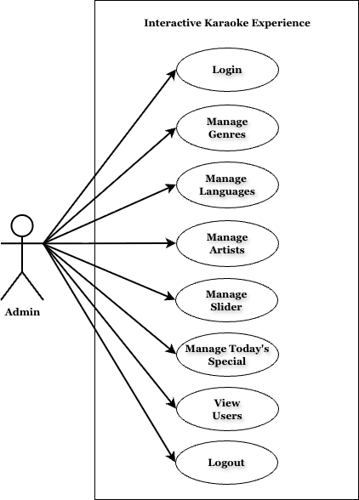
Admin Use-Case Diagram

Slide 23
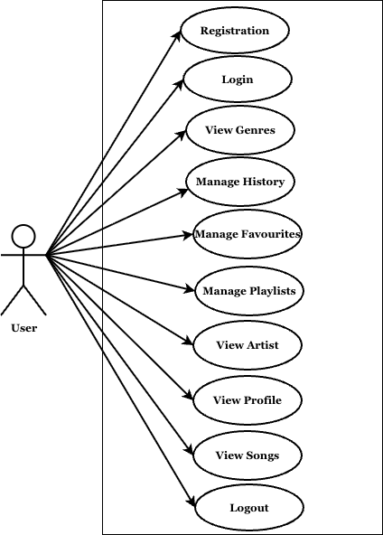
User Use-Case Diagram

Slide 24
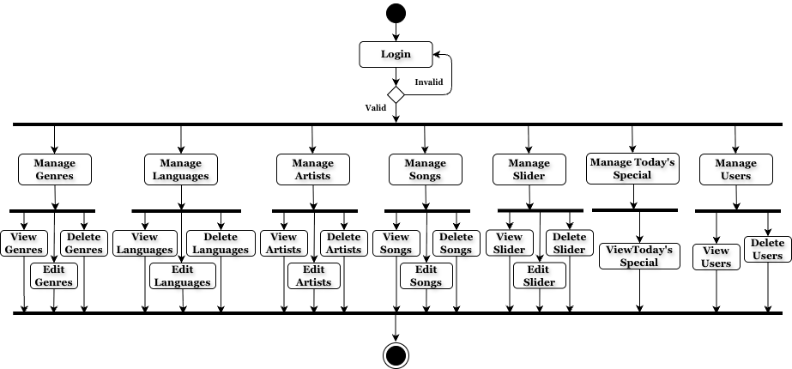
Admin Activity Diagram

Slide 25
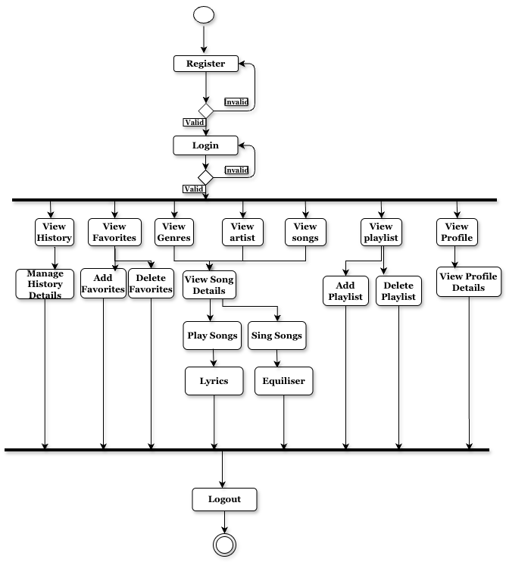
User Activity Diagram

Slide 26
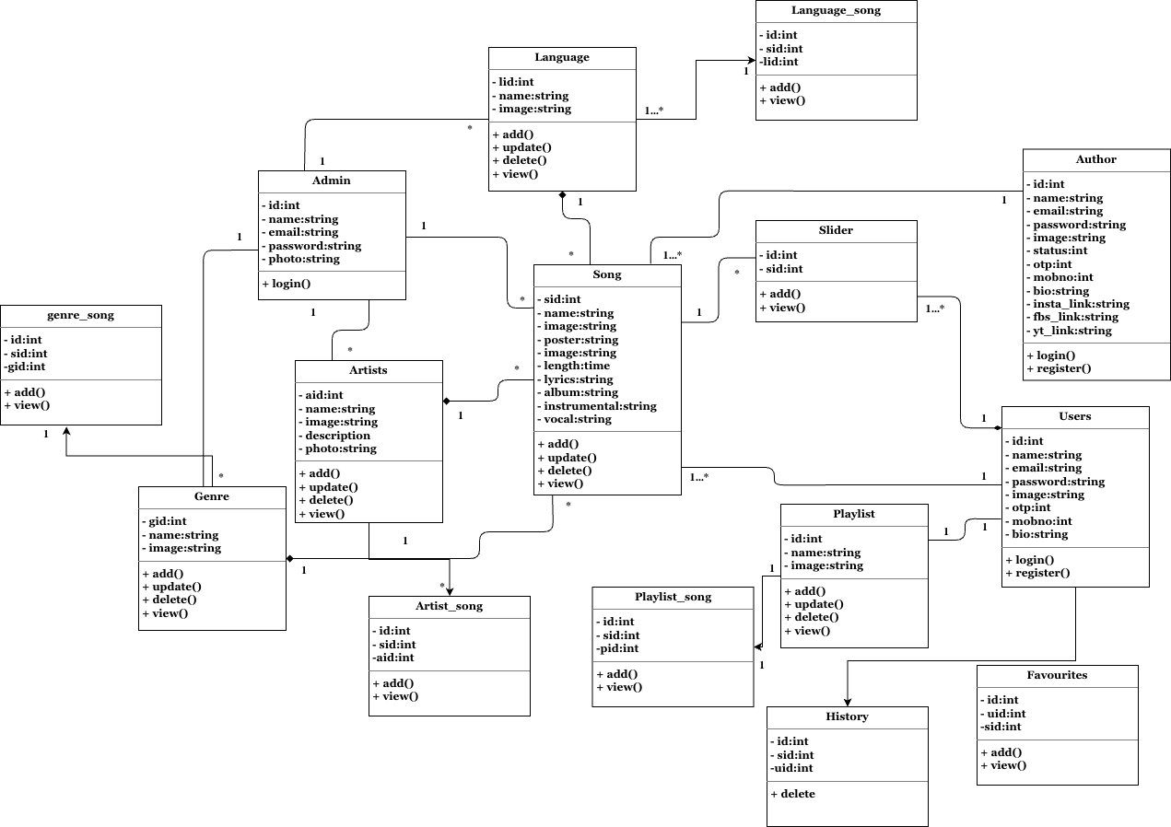
Class Diagram

Slide 27
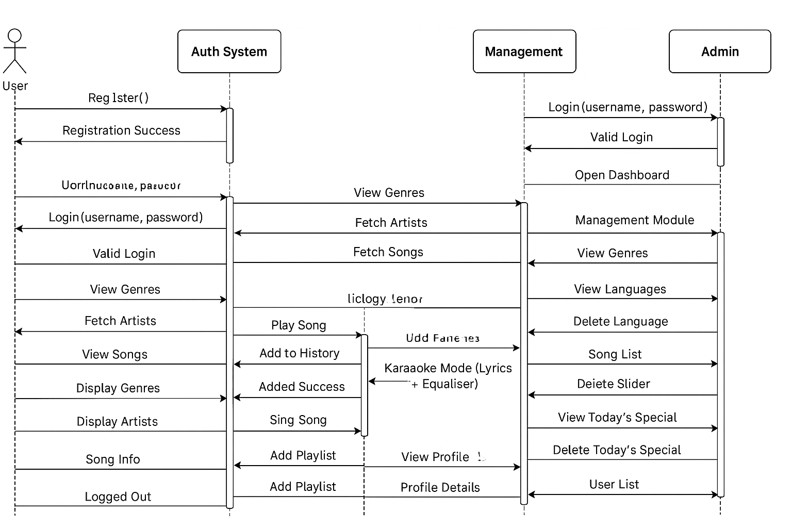
Interaction Diagram

Slide 28
ScreenShots

Slide 29
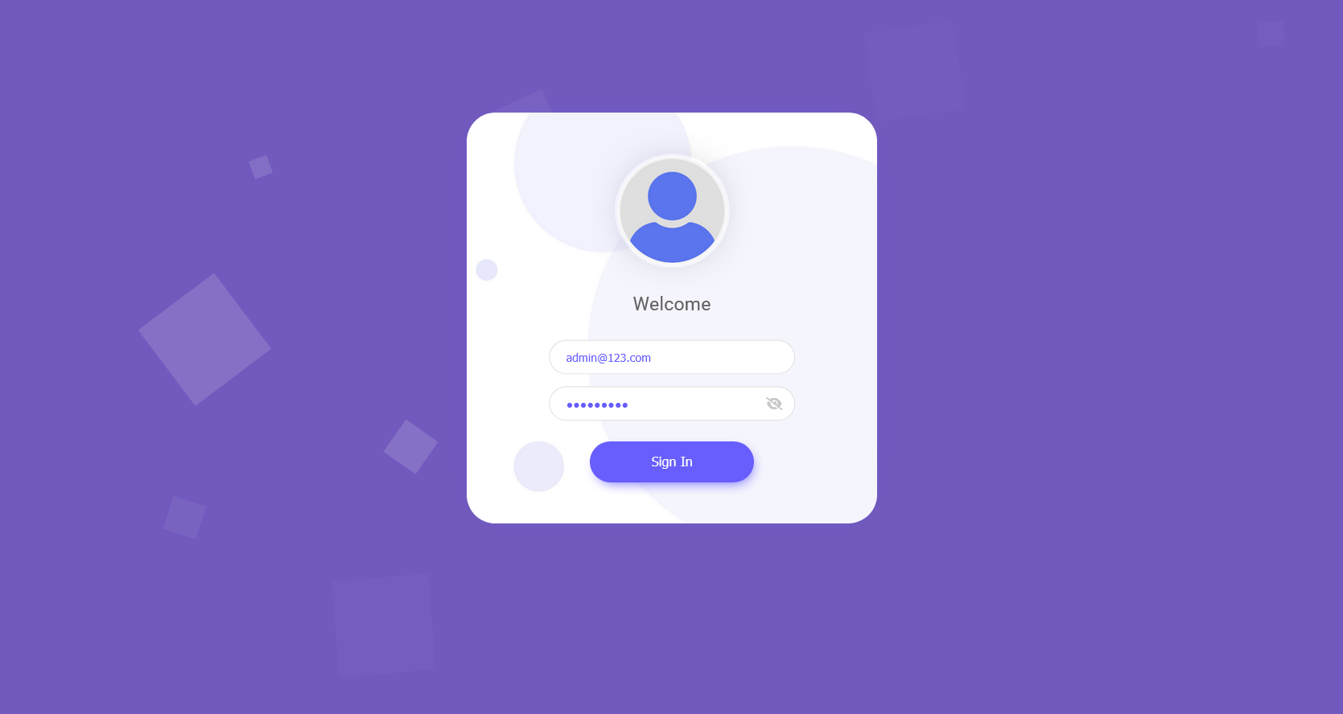

Slide 30
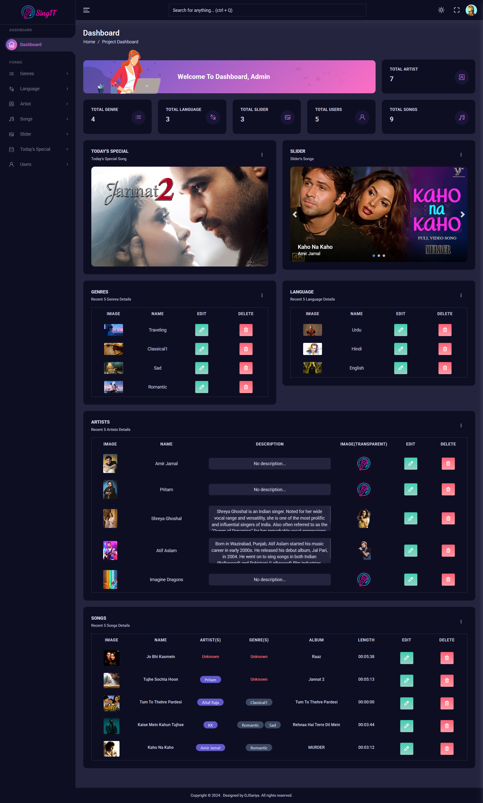

Slide 31
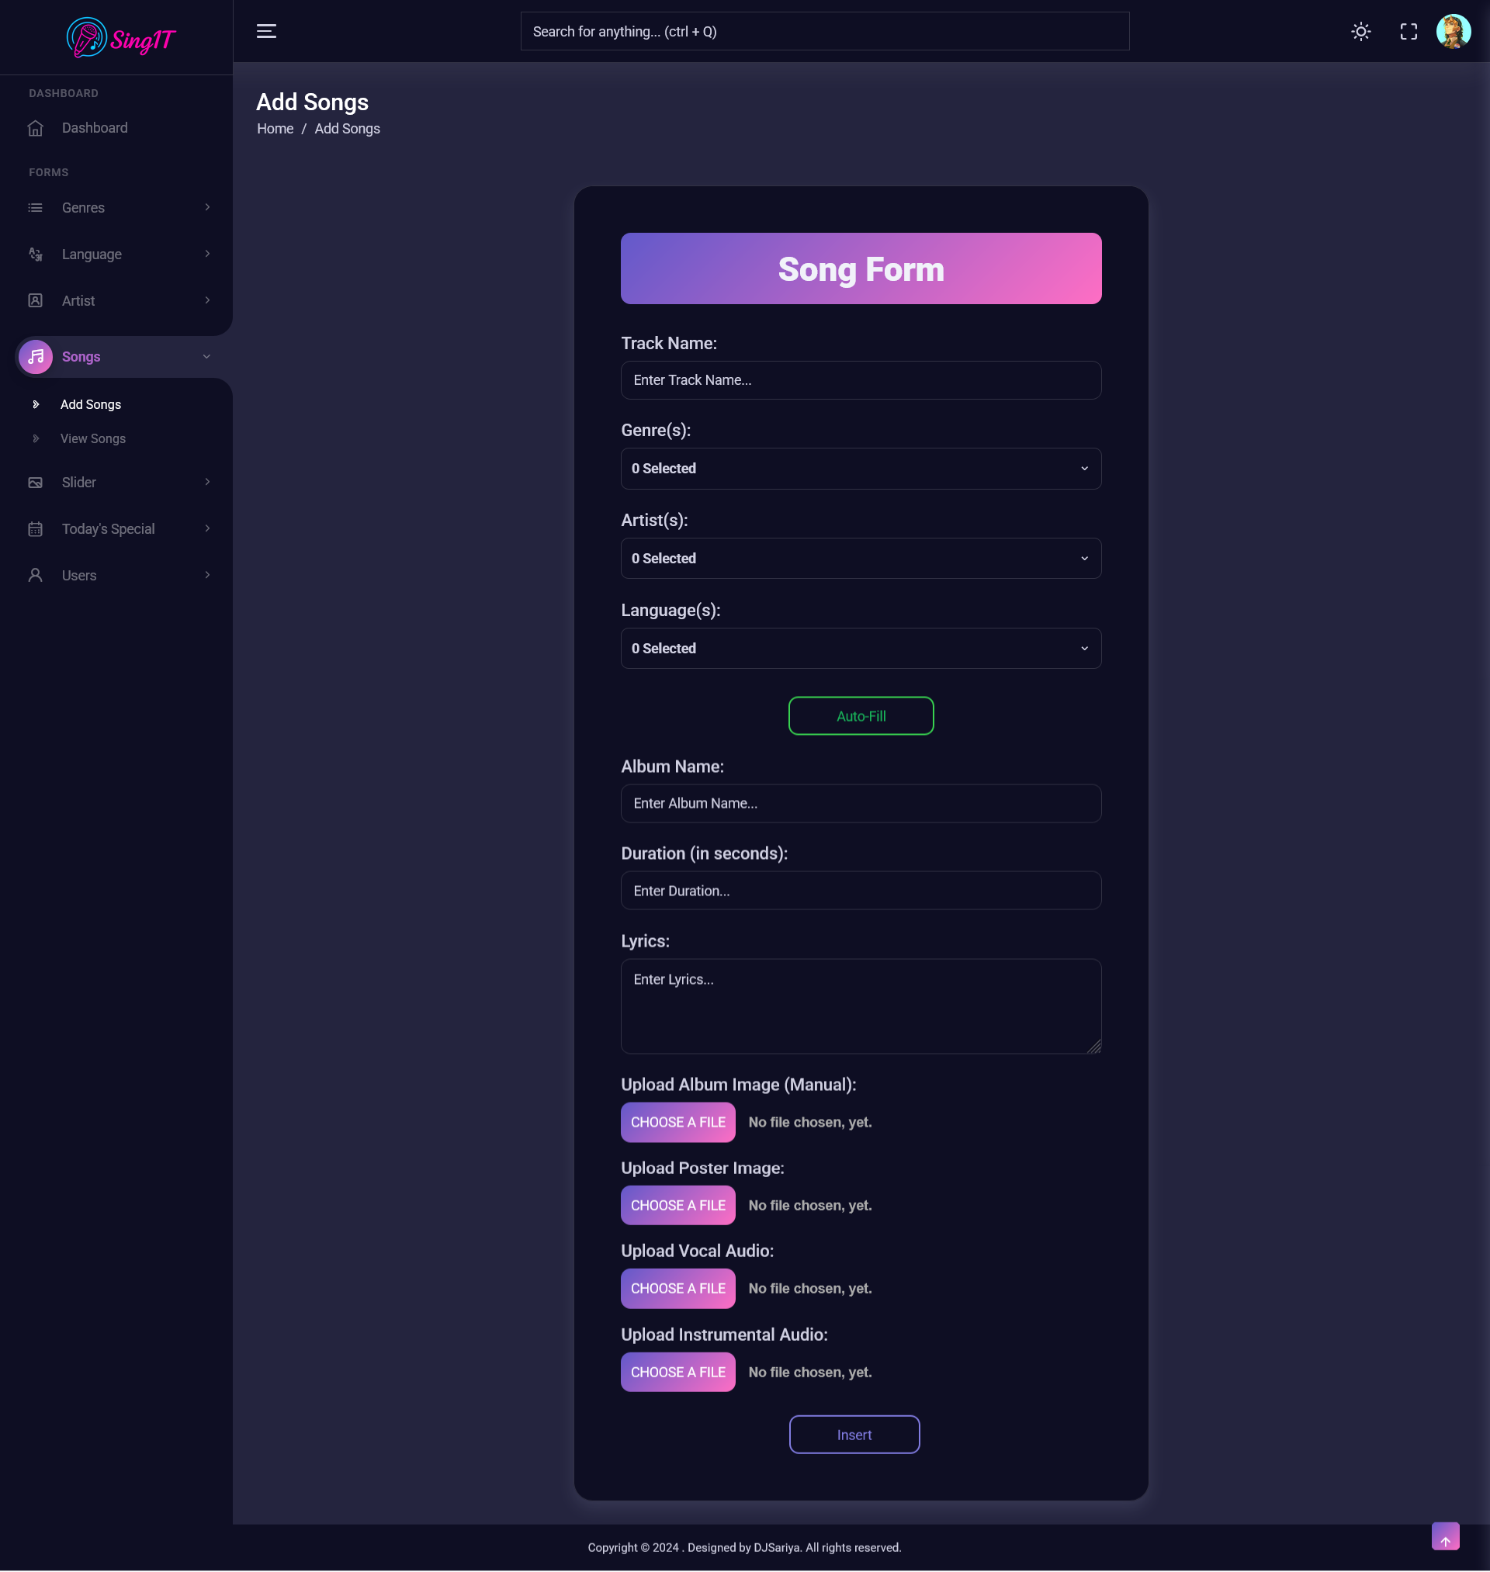

Slide 32
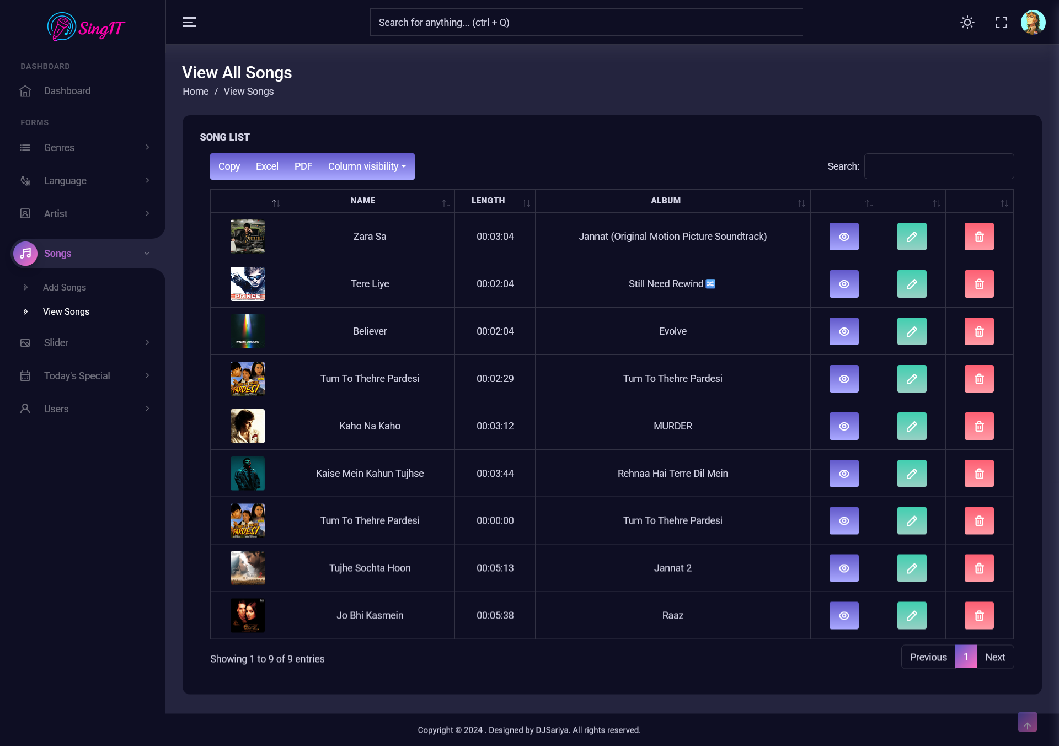

Slide 33
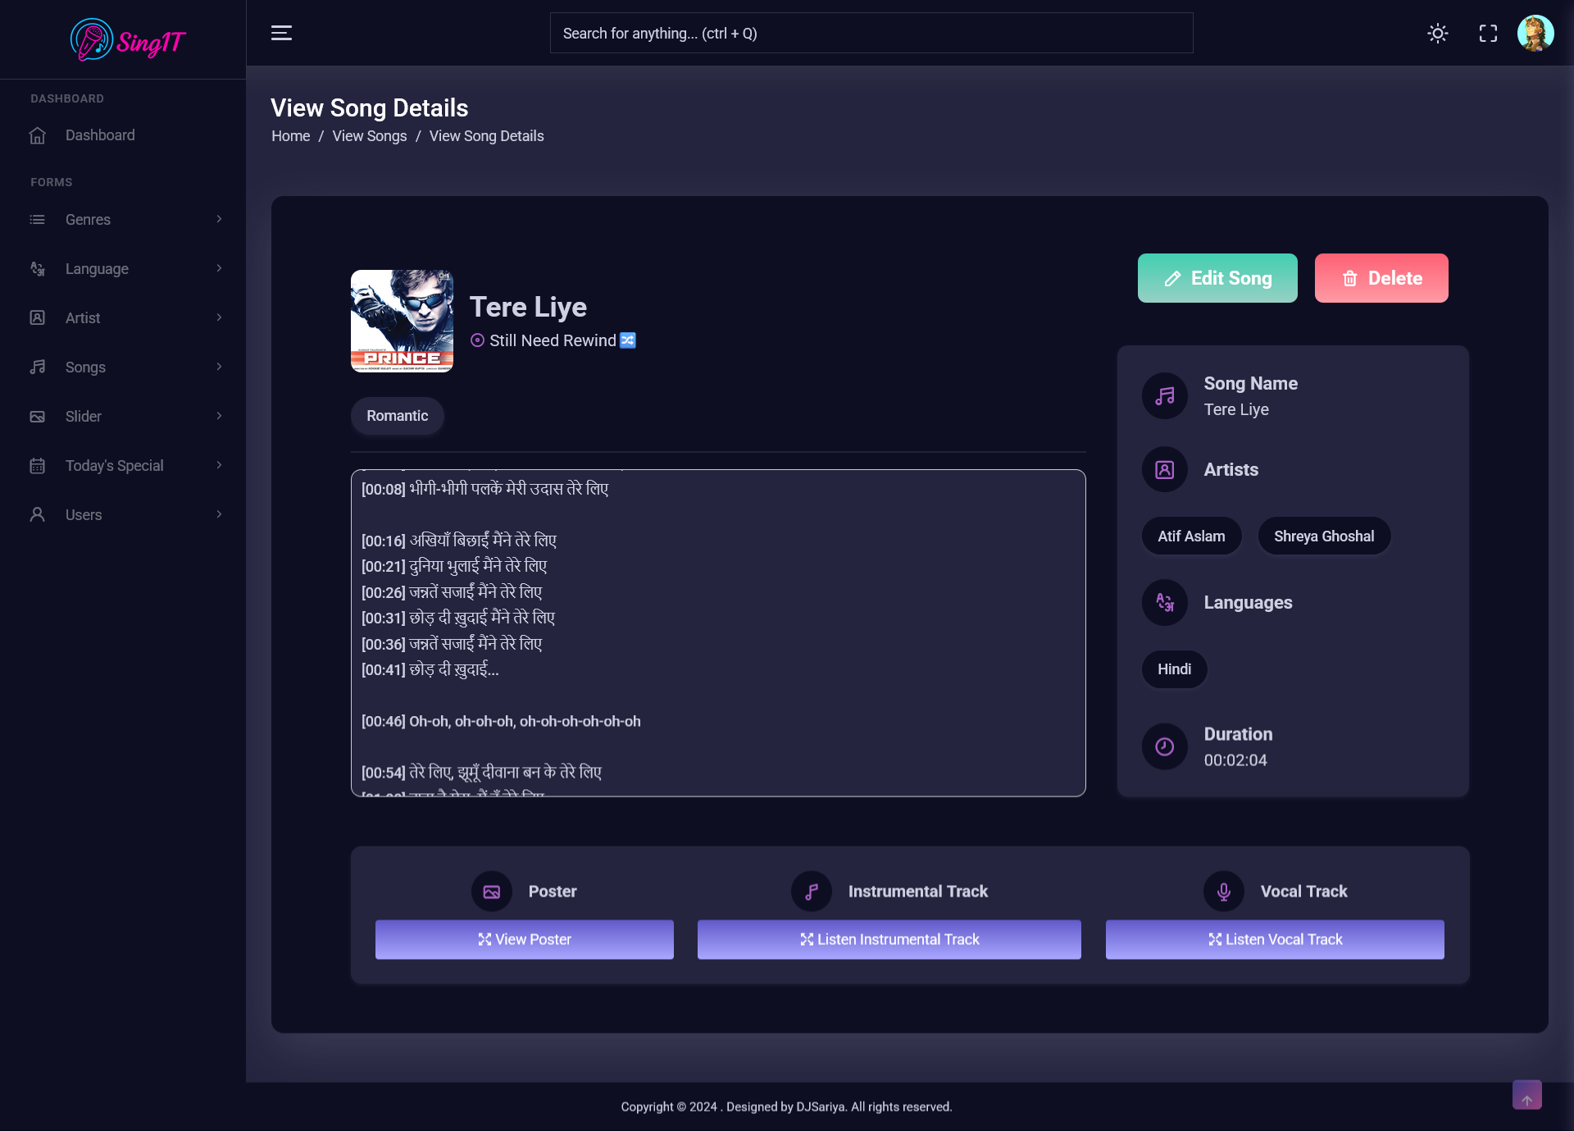

Slide 34
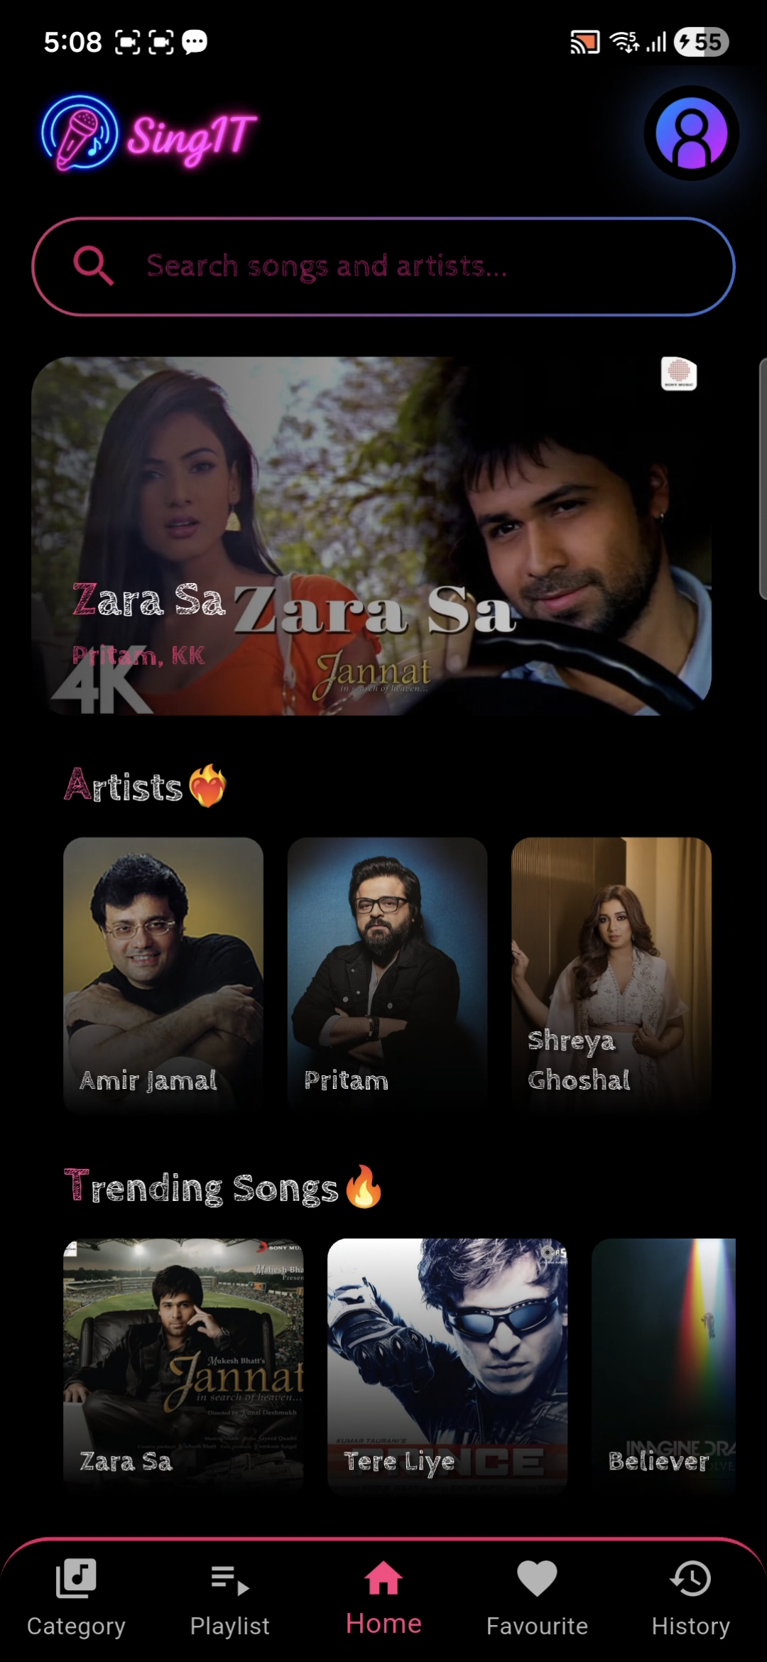

Slide 35
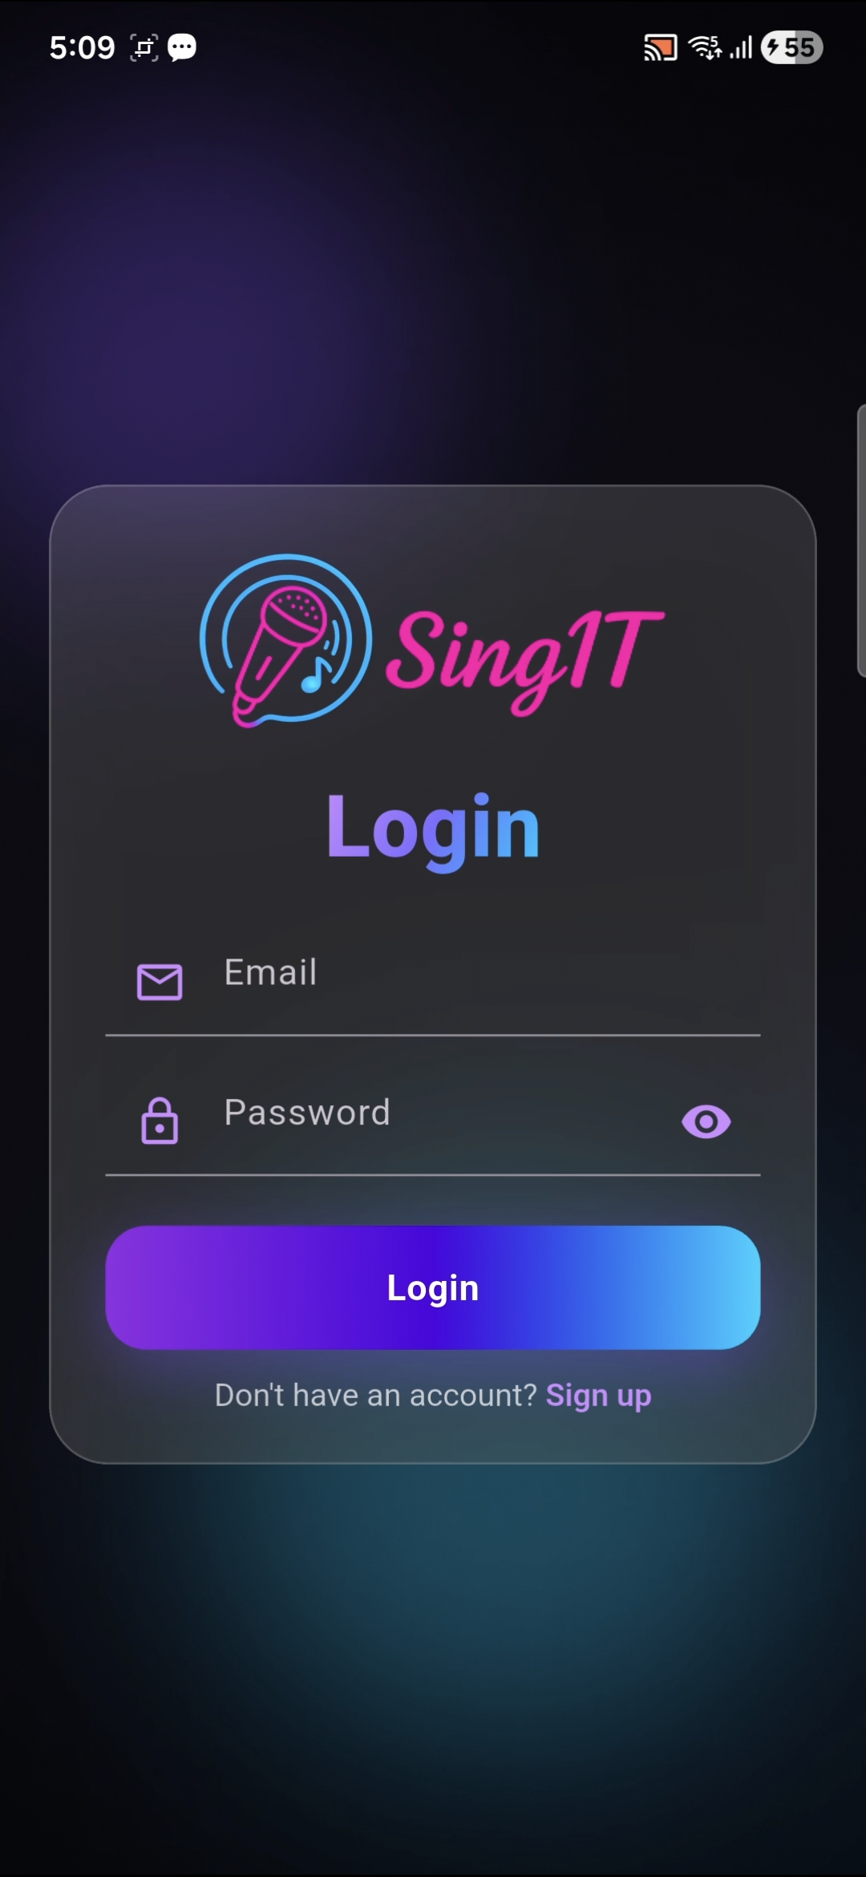

Slide 36
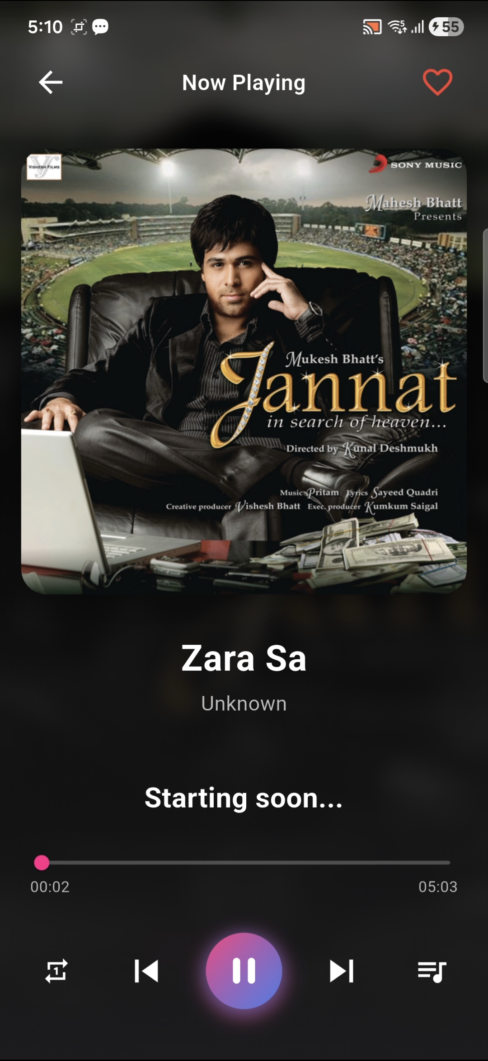

Slide 37
Limitations
Audio Quality Issues – Vocal and instrumental separation may not always be 100% accurate, leading to background noise or distortion.
Performance Constraints – Real-time processing of songs requires high CPU/GPU power, which may affect performance on low-end Android devices.
Internet Dependency –Streaming and Storing may need a stable internet connection as it directly been stored on Cloud.
Background Noise in Recording – User’s recording quality depends on the device microphone and environment.

Slide 38
https://flutter.dev/learn https://www.codeofaninja.com/create-simple-rest-api-in-php/ https://www.w3schools.com/graphics/google_maps_intro.asp https://stackoverflow.com/?gad_source=1&gclid=CjwKCAiA6aW6BhBqEiwA6KzDc8dlD25tlurLWp8ZRkkVar6jQ6s3HHf4I5bIV6Gva EetMzECBNembxoC8DIQAvD_BwE https://www.geeksforgeeks.org/c-programming-language/
References

